Slide 1
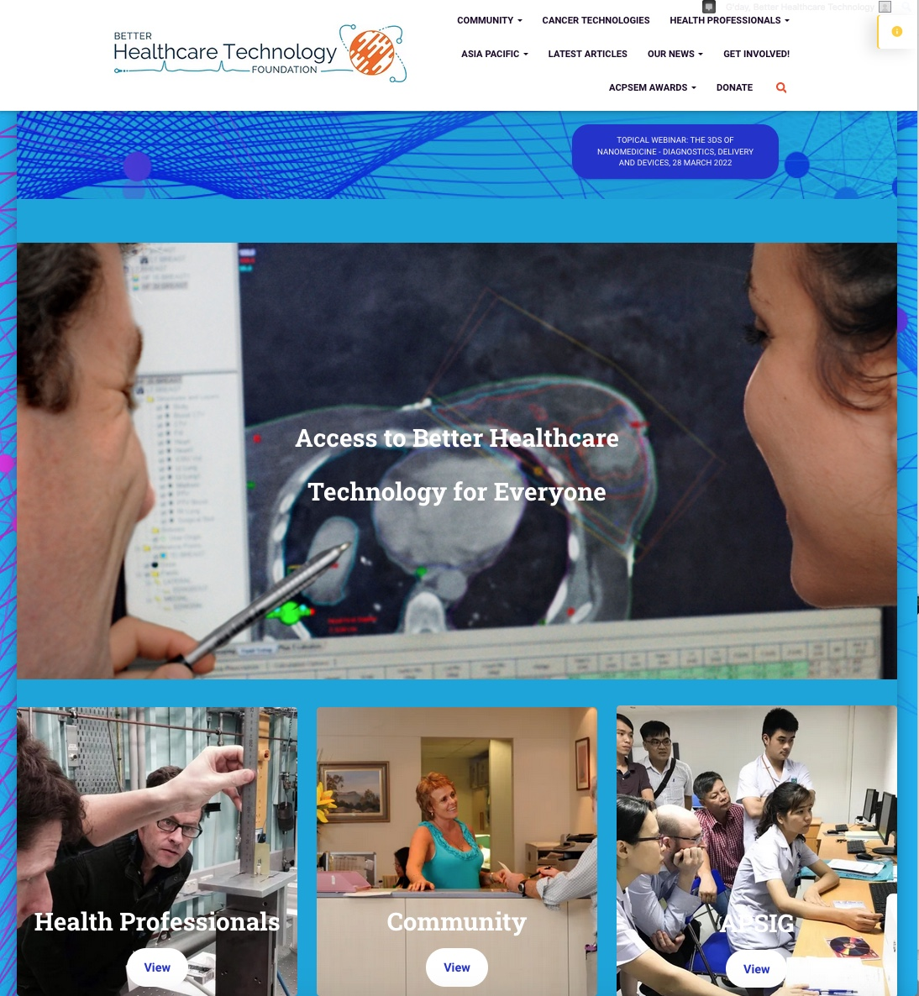
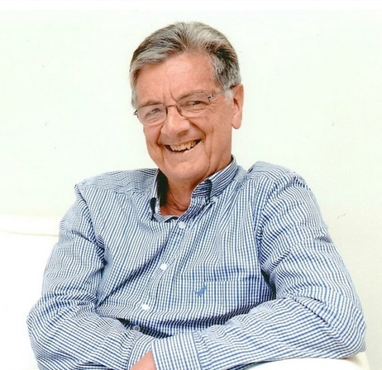
ACPSEM Foundation Ltd T/A Better Healthcare Technology Lyn Oliver AM MSc PhD 18 March 2022

Slide 2
ACPSEM Foundation Ltd
Community
Health Professionals
Asia Pacific
Registered charity of the Australasian College of Physical Scientists & Engineers in Medicine (ACPSEM).
and
Trades as the Better Healthcare Technology Foundation,
Purpose: Why begin the journey?
To:
promote ACPSEM research and development;
and
promote safe, and appropriate use of medical technology for the benefit of ANZ and Asia Pacific patients.

Slide 3
ACPSEM Foundation Ltd
Community
Health Professionals
Asia Pacific
Reach Out
Research & Development
Training & Education
Our Mission:
(The path to get to our destination and what to achieve (the four pillars))
Promote research and development in Australia and New Zealand
Support training and education initiatives in low to middle income countries
Facilitate knowledge exchange with health professionals and the community
Undertake other charitable activities that align with the objects of the Foundation

Slide 4
ACPSEM Foundation Ltd
ACPSEM Foundation Ltd
T/A Better Healthcare Technology Foundation
Vision:
(What we aspire to achieve in the future)
Access to better healthcare technology for everyone.

Slide 5
For a Sustainable Foundation
What we need:
Administrative governance support to satisfy ACNC charitable registration; ✓
Fund resources (strategic plan for income versus expenditure and ‘sinking’ fund); ✕
Funds for knowledge exchange (meetings, workshops and website); ?
Member support ✕
(donations, participation in committees, fund raising and website team);

Slide 6
Website Support
We need your support for:
Web Editorial team (website governance);
Co-editors (website standards and expert reviewers);
Authors (Articles set at levels 1 – 3 complexity and full topic range);
‘Article spotters’ (specialist topic co-ordinators)
Website co-administrator(s) (for Wordpress support);

Slide 7
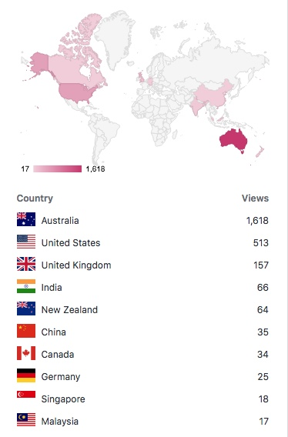
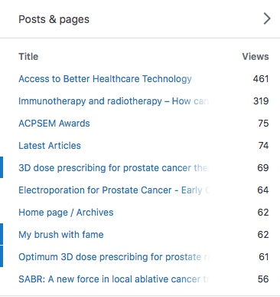
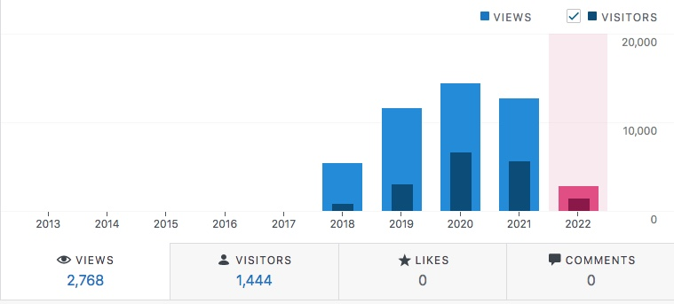
Website
Statistics

Slide 8
The Operational Plan
(what, why, how)

Slide 9
Community Knowledge Exchange

Slide 10
Community Knowledge Exchange
What to do?
Foster research and knowledge exchange that focuses on the prevention, diagnosis, and treatment of systemic diseases (such as cancer, diabetes and mental illnesses).
Publish website information which is:
Suitable for patients and the community (including students and health professionals):
Is expert scientific and technical material; and
is up-to-date.

Slide 11
Community Knowledge Exchange
What to do?
The information:
describes the design and operation of modern health technology;
complements published medical advice; and
must be reasonably concise and readily understood by patients, students and the community.

Slide 12
Community Knowledge Exchange
What to do?
The website material should be:
a recognised, independent, free of conflict source; and
designed to help reduce patient anxiety or concerns when they:
are seeking technical information;
deciding the mode of treatment; and
consulting their medical specialist(s).

Slide 13
Community Knowledge Exchange
Why do it?
We must gain consumer/community confidence by providing:
patients, community and health professionals, easy access to relevant, free-of-conflict information;
high quality, ethical website and lecture content which meet:
international standards; and
are regarded as reliable healthcare information for public use;
NOT Fake News!

Slide 14
Community Knowledge Exchange
How to do it
The website should offer information:
that addresses patient concerns about medical technology equipment, its operation, safety, method of treatment or diagnostic accuracy;
for students and those seeking medical technology information or a career; and
a flexible platform for everyone’s use (easily change as needed).
It’s a particularly valuable website. It provides knowledge in a form not readily available anywhere else.

Slide 15
Community Knowledge Exchange
How to do it: BHT Website Articles
‘Whitepaper’ information;
Articles cover diagnostic, therapy or surgical healthcare technology;
The articles are of level 1 - 3 in complexity to cater for the broad variety of viewers – examples:
Level 1 What is stereotactic radiation therapy?
Level 3 EPID position error tests of small multi-leaf X-ray fields
All articles are written in an easy-to-read-and-understand style.

Slide 16
Community Knowledge Exchange
How to do it : Level 1. consumer information
The website articles are suitable for:
1. patients and their families 2. high school students
3. undergraduates and postgraduates 4. other health professionals
and any member of the public seeking up-to-date information of modern medical technology.

Slide 17
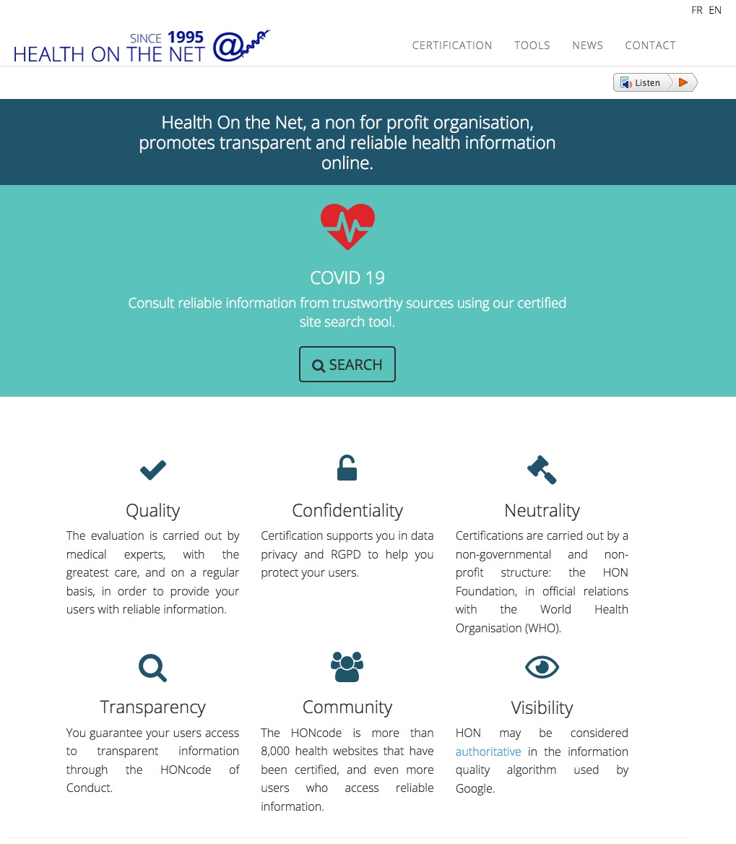
Community Knowledge Exchange
What to do?
Obtain International Certification for the Better Healthcare Technology website. (see, for example, Health On the Net)

Slide 18
Community Knowledge Exchange
The end goal:
The Foundation’s website provides:
Global access to our healthcare technology information; and
Aims to give patients better information access to learn about high quality healthcare technology.
Access to better healthcare technology for everyone.
Note: The Foundation’s information is restricted to scientific and technical aspects. Patients are referred to medical practices for any medical advice.

Slide 19
Community Knowledge Exchange
Grant applications:
Patient access to medical technology information
($70k grant application submitted to Perpetual Ltd)
The aim of this project is to:
find and build practical pathways for patients to access information about the medical technologies used in their treatments, particularly for cancer treatments.
This information will complement the doctor’s medical advice.

Slide 20
Community Knowledge Exchange
Grant application:
Prostate cancer patient information – pilot project
($15k grant application submitted to the James Kirby Foundation)
The aim of this project is to:
support patients diagnosed with prostate cancer. The project aims to find and build practical pathways that can provide them access to information about the medical technologies used in their treatments which can assist their decisions on treatment.
The information will complement the doctor’s medical advice.

Slide 21
Health Professionals

Slide 22
Health Professionals
What to do?
Our Goal for Health Professionals
Promote medical technology R&D .
Facilitate collaborative knowledge exchange with other health professionals and the community on:
safer, more appropriate imaging and therapeutic technology;
and
the prevention, diagnosis, and treatment of systemic patient diseases
(such as cancer, cardiac and mental illnesses).

Slide 23
Health Professionals
What to do?
Stronger Collaboration Projects
Promote stronger collaboration of health professionals, particularly in local and remote hospitals to:
bridge-the-gap with universities and industry; and
enhance the translation of new, safe, and appropriate technology;
Provide staff support to:
improve write-up and reporting skills about their clinical observations or work initiatives; and
make closer professional ties between smaller and larger clinical research centres.

Slide 24
Health Professionals
Why do it?
Stronger Collaboration Projects
Knowledge exchange is essential.
Staff responsible for high-technology, diagnostic and therapeutic equipment and its use, should receive upskill training
- particularly in medical centres sparsely distributed throughout country areas.
Upskilling of emerging technologies is important to:
maintain local expert skill levels; and
retain adequate rural and remote centre health professional staff.

Slide 25
Health Professionals
Why do it?
Stronger Collaboration Projects
Better communication networks and knowledge exchange between centres would:
strengthen research and development activities; and
would help focus on new scientific and engineering upgrades, clinical trials and on-the-horizon new research.
(be inclusive and collaborate).
To reduce professional isolation and lack of opportunities, staff in smaller or isolated centres should receive support to upgrade their skills, research and development.

Slide 26
Health Professionals
How to do it
Stronger Collaboration Projects
We propose to:
Draw on the collective skills of Foundation and ACPSEM members to:
mentor and support younger or isolated health professionals with research activities and ‘brainstorming’ events;
and
foster collaboratively translational and best practice research.

Slide 27
Health Professionals
How to do it
Encourage better healthcare technology by:
awarding prizes and grants to health professionals for outstanding achievements or innovative projects.
Build health professional relationships, collaboration and raise interdisciplinary professional awareness between:
hospitals, universities, industry and government health bodies;
allied organisations; and
patient support organisations.

Slide 28
Health Professionals
How to do it
Stronger Collaboration Projects
Encourage members to publish website articles on the new innovative areas, such as:
adaptive radiotherapy;
artificial intelligence (many specialties);
biomarkers (surgery and imaging);
image resolution and fusion (surgery, radiotherapy, cardiology and diagnostic imaging);
3D printing (rehabilitation surgery);
targeted radiotherapies (radiopharmacy and cyclotron technology); and
tumour tracking (radiotherapy)

Slide 29
Lyn Oliver AM PhD MSc FAIP FACPSEM
Thank You

